Slide 1
Insert name of ACP session hosted by your organization
Insert facilitator name
Insert 2nd facilitator name
Sponsoring Organization name and logo
For this slide: you can use your own template
Notes:
Notes to facilitators:
This slide is meant to be personalized with your own information – use your own template; add names of facilitators and sponsoring organization
These Notes pages of the PowerPoint can be used as a guide for the facilitator, however, the Facilitator Guide is more in depth than the PowerPoint slides and Notes and will provide you with more background information to facilitate the session and feel prepared for questions from participants.
Incorporate stories throughout to create “the hook” to engage people in the discussion about why ACP is important for everyone, in all stages of life. Use a compelling video or story about ACP (even yours) - ensure the story reinforces the message about the importance of conversations on health care.
There are questions throughout to initiate discussion with the group. These conversations are an important part of helping people become more comfortable with talking about ACP and related topics.
The key messages are on the slides. What extent of information from the Notes you are able to add will depend on the amount of conversation happening in the group and balancing conversation and information within the time available.
Option: Depending on the size of an online group and the level of familiarity with an online platform, when you pose a question you may want to suggest that everyone take a minute to add their thoughts to the chat box then read them all out loud and validate responses.
Option: You may want to divide the session into two shorter sessions or to allow more time per session for conversations and review of the information. Some suggestions:
End the first session after slide 29 which summarizes the session to this point
Assign participants ‘homework’ – Think about your values, beliefs and wishes for your future health and personal care and perhaps try a conversation with someone you trust (depending upon the amount of time between sessions).
At the beginning of the second session –
repeat slide 29 to remind everyone about what was covered in the first session
ask for any questions or comments from the first session
review the homework and ask for any volunteers to share how it went for them to think about their values, beliefs and wishes for their future health and personal care and perhaps try a conversation with someone.

Slide 2
My Wishes, My Care
Advance Care Planning for the public
Think, Talk and Plan
about your future health care
October 2020
Notes:
Starting the session:
Welcome participants
Acknowledge the Indigenous land/territory that you meet on
“I would like to acknowledge with respect the history, customs and culture of the [Insert First Nation name], on whose traditional territory and home we meet.” (see the Facilitator Guide for where to find the First Nation you are to acknowledge)
Introduce yourself, co-facilitators and tech support person (for online session)
Provide brief information about host organization
Review housekeeping:
In-person: Emergency exits, washrooms, parking, refreshments, cell phone use (silent mode), etc.
Online: functions of online platform (camera, mute, raise hand, chat, breakout rooms, etc.)
To minimize distractions, recommend participants only turn on cameras (optional) and unmute microphones during discussions.
Breaks: minimum one (1) 10-minute break per session
Let participants know about handouts and evaluation forms to be provided at the end of the session
(This work is licensed under a Creative Commons Attribution-Noncommercial-NoDerivatives 4.0 International License.)

Slide 3

About Advance Care Planning …
Notes:
This slide is a placeholder – you may want to change it for a slide and a photo of your own.
To help with engaging participants, share a personal story or example from a book or video about an experience with Advance Care Planning. An experience that includes elements of thinking, talking and planning will help tie in with the presentation.

Slide 4
Our focus for today’s session
To support you in your Advance Care Planning –
the what, why, who, when and how of ACP
thinking about what is important to you
the importance of talking to others so they know what matters most to you
how to choose the best person to speak on your behalf if you are not able to speak for yourself.
Notes:
Explain what the session will cover:
Today’s session is about Advance Care Planning in British Columbia, a process to help you get the kind of health care you want throughout your life.
You will learn:
the what, why, who, when and how of planning for your care.
to think about what is important to you. This will help you decide what kind of care fits with your goals, values, and wishes.
the importance of talking to others so they know what matters most to you.
how to talk to others.
how decisions are made when you aren’t able to make them for yourself.
how to choose the best person to speak on your behalf if you are not able to speak for yourself.
Our emphasis today is on the thinking and talking — then introducing the planning and providing you with resources to support your advance care planning
Please note that the sessions will not cover:
advice specific to your own situation
assistance with completing an advance care plan or filling out any forms or documents

Slide 5

Guidelines for discussion
  Respect other’s opinions
  Respect other’s privacy
  You don’t have to talk in the group if you don’t want to
  Be sure to ask questions if you need more information
Notes:
Introduce guidelines for discussion
Before we start our session today, I would like to remind us all that we need to:
Respect other’s opinions. We will be talking about things that are very personal. We may not all agree with each other, but everyone has a right to their own opinions.
Respect other’s privacy. Please do not share other’s stories or personal information.
You don’t have to talk in the group if you don’t want to. I understand that some of us don’t feel comfortable talking in a group.
Be sure to ask questions if you need more information. If I am not able to answer any of your questions in the session, I will try to tell you where you can find answers after the session.
Additional Guidelines for Online Sessions:
If you wish to participate in the conversation or have a question, you can:
Use raise-hand function,
Physically raise hand on camera;
Write your comment or question in the chat box, which will be monitored by <name of co-facilitator/assistant> and shared verbally with the group.
Also explain how to use the breakout rooms or polls if you decide to use these features.
Explain your role as facilitator in the session:
To provide information and resources about ACP, and to share examples.
Answer your questions or help you know where you can find answers after the session.
Ensure we all follow the guidelines for discussion.

Slide 6
Before signing up for this session, had you heard of the term “Advance Care Planning”?
Notes:
Discussion Break: Invite discussion to find out how familiar participants are with Advance Care Planning
Ask: Before signing up for this session, had you heard of the term “Advance Care Planning”?

Slide 7
Advance Care Planning is
thinking about your values, beliefs, and wishes for future health and personal care, and
sharing them with the people you trust.
It can include choosing who would make care decisions for you if you cannot.
Advance Care Planning can help you get the care that’s right for you.

Slide 8



ACP is part of life planning …
Notes:
Do not expect participants to answer – these are for reflection only:
Here are some questions to think about:
Have you made a will?
Have you saved money for your children's or grandchildren’s education?
Have you decided who could be guardians for your children?
Have you a plan for retirement?
Have you needed to make a difficult health-care decision?
Have you helped someone else go to medical appointments and helped them understand what was said?

Slide 9
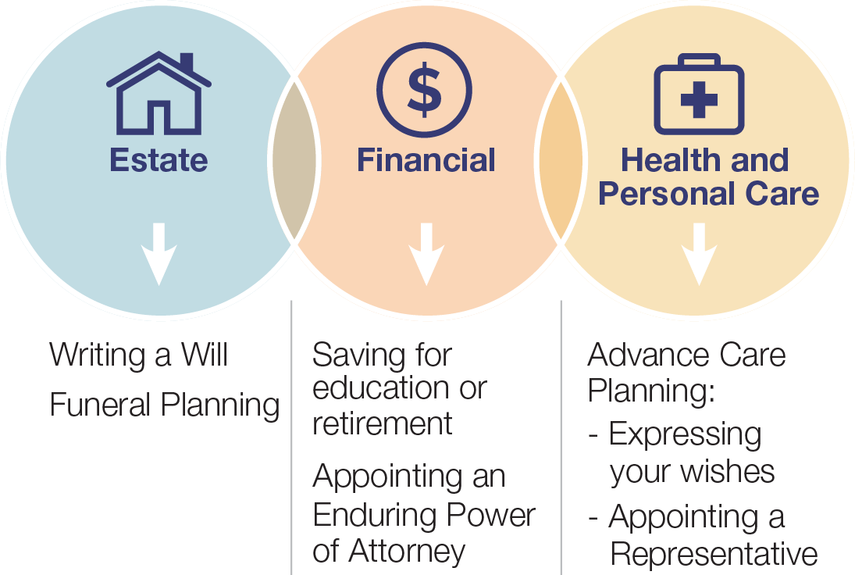
Advance Care Planning is part of life planning
Notes:
Explain that health-care planning is just as important as financial and estate planning:
Life is a complicated journey full of ups and downs. To make life easier, most people do some form of life planning for themselves and their families. They plan for tomorrow so they can live for today. Each type of planning includes thinking, talking, and planning to make sure we can have the life we want. Planning can also include recording our choices in forms or documents.
Estate planning:
People make wills to say what they want done with their assets when they die, and if needed, to appoint guardians to look after their children.
Financial planning:
People save money for school, major purchases and retirement. They buy insurance in case something happens to their house, car or themselves.
Personal-care planning:
People make preparations for day-to-day life decisions such as:
Living arrangements
Diet and dress, and other day-to-day decisions
Exercising
Driving
Working
Deciding who you have contact with
Any cultural traditions that are important to you
Types of clothing for special occasions
Foods that are nourishing
Health-care planning:
People prepare for changes in their health, so they are ready to make decisions. They also prepare for situations where they cannot speak for themselves, and who will speak for them if this happens.
Just like you change your financial and legal plans for each stage of your life journey, your health-care plans should be updated, too.

Slide 10
Why do you think Advance Care Planning is important?
Notes:
Discussion Break: Why do you think Advance Care Planning is important?
Summarize what people have shared before moving forward.
Explain the importance of doing ACP
Importance of ACP in Canada
In Canada, when you are ill and need health care, you can choose whether you say yes or no to the tests, examinations, and treatments your health-care provider recommends.
Your health-care provider can only provide care that you want and agree to .
Before you make any decisions, your health-care provider will explain to you the risks and benefits of the health care options.
When deciding, it helps to think about what difference it will make in your life.
It’s important that the health care we receive matches our goals, values, and preferences.
Advance Care Planning can help make that happen.
Facilitate a discussion to allow sharing of the impact that having an ACP (or lack of) had on their family or friends
Acknowledge how life can change at any moment!
Here are some examples you could use:
Mrs. Smith didn’t do any Advance Care Planning and was in a serious car accident resulting in a brain injury that left her unconscious and a spinal cord injury that may leave her paralyzed from the neck down. The hospital could not find anyone who could make decisions according to her wishes.
Pam needed someone to make decisions for her for a short time after undergoing heart surgery. After a few days of recovery, she was able to go back to making her own decisions.
Henry had a stroke and could not make his own decisions. He didn’t have any written plans, but his spouse was with him and knew what his wishes were.
Mr. Johnson has late-stage dementia and didn’t do any Advance Care Planning. His family and friends have different ideas about what his wishes for health and personal care are from previous conversations but cannot come to a consensus and do not know who they should be listening to.

Slide 11



Benefits of Advance Care Planning
For you For your family For your
and friends health-care providers
Notes:
Explain the benefits of Advance Care Planning to everyone – for you, family and friends, and health care providers
Advance Care Planning can benefit everyone, regardless of health and stage of life.
You may not have any health concerns, but being ready in case a health crisis happens will ease the burden on everyone.
It is especially important for people living with serious illnesses - such as dementia, cancer, heart disease, or kidney disease - to begin the process as soon as possible.
Advance Care Planning helps people diagnosed with serious illnesses prepare themselves and the people important to them for the future.
For you:
An important part of your life planning.
Can help you get care that is right for you and aligned with your values, preferences and wishes.
Allows you to know yourself better and to understand what’s important to you.
Can bring you peace of mind, knowing that people you trust know your health care wishes in case you aren’t well enough to speak for yourself.
For your family and friends:
A gift you give your family. It lets those who care about you know what care you would (or would not) want.
Makes it clear to everyone in your family and friend circle who you want to make care decisions for you if you can’t.
Reduces family disputes and confusion about your health-care wishes.
Helps your decision maker communicate better with your health-care team
For your health-care providers:
Lets your health-care providers know what kinds of things in life are important to you.
Helps your health-care providers know more about your culture and beliefs and how they affect your care decisions.
Helps your health-care providers know what life support or care options you would refuse to receive if needed.
Lets your health-care providers know who will make decisions for you if you cannot make them for yourself.

Slide 12



Who should do Advance Care Planning?
Notes:
(Photo that shows a variety of different people comes in on second mouse click so that you can ask the group the question first)
Discussion Break: Who do you think should do Advance Care Planning?
Invite participants to share their thoughts.
Explain: Advance Care Planning is for everyone!
All adults, 19 years and older, who are capable of making health care decisions should do Advance Care Planning, especially people who:
have a serious illness
think their family may have different views or beliefs from their own
have family members who don’t know, understand, or support their health-care choices
have a condition, such as dementia, that will lead to a loss of capacity to make decisions

Slide 13





When to do Advance Care Planning?
Notes:
(Photos showing different life stages appear on second mouse click to allow you to ask the question of the group)
Discussion Break: When should we do Advance Care Planning?
Invite participants to share their thoughts.
Explain:
The sooner you start the better.
What you think about and plan for in your Advance Care Planning will be different at different stages of life as things can change at any time.
This means we will need to be reviewing our Advance Care Plan as life progresses.
You should consider doing Advance Care Planning at these times:
When you experience a significant change or major event in your life, such as:
Changes in health
Changes in your relationship (including common law, marriage, divorce)
Having children/grandchildren
Retirement
Buying/selling property
Upcoming surgery
Moving
When a serious illness happens:
On diagnosis
If your health declines
On diagnosis of terminal illness

Slide 14
Advance Care Planning …
What: thinking about your values, beliefs, and wishes for future health and personal care, and sharing them with the people you trust.
It can include choosing who would make care decisions for you if you cannot.
Why: helps you get the care that is right for you
Who: it’s for every adult
When: the sooner, the better!
Notes:
Before moving on, summarize the information shared so far:
What: Advance Care Planning is a process that involves thinking about and sharing your wishes and preferences for health care and personal care with the people you trust. It can include choosing who would make these care decisions for you if you cannot do so. It is a part of life planning.
Why: Advance Care Planning helps you get the care that is right for you and aligned with your values, preferences and wishes, even if you’re unable to speak for yourself.
Who: It’s for every adult, not just for people who are old or ill.
When: The sooner you start your ACP, the better!
When: Advance Care Planning is not a one-time event. It’s recommended that you review your plans at key times in your life, like when there are changes to your health or close relationships.

Slide 15
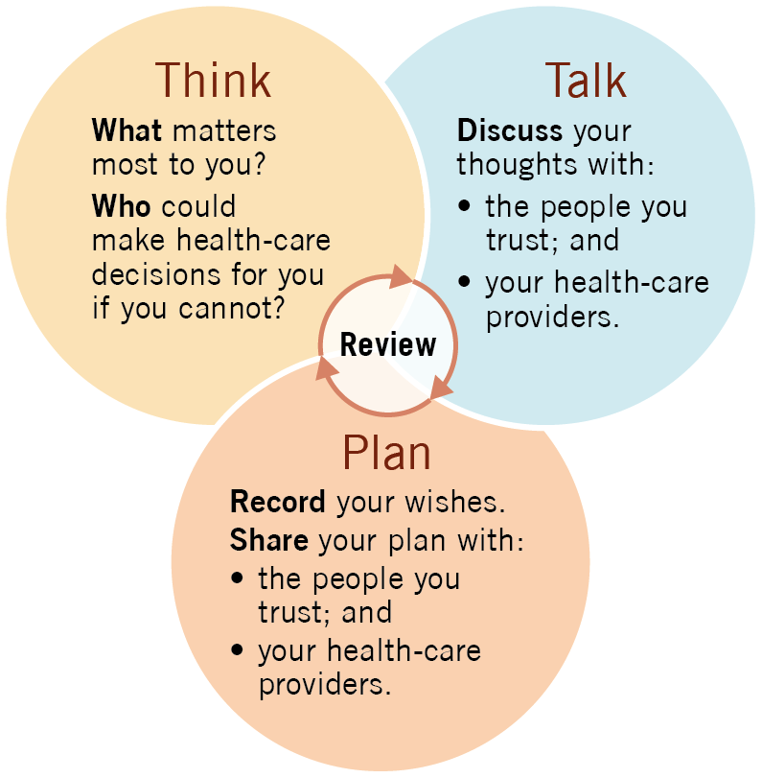
How to do ACP?
Think
Talk
Plan
Notes:
Explain the 3 simple steps of ACP:
Think: What matters most to you?
Who could make health-care decisions for you if you cannot?
Talk: Discuss your thoughts with
the people you trust, and
your health-care providers
Plan: Record your wishes
Share your plan with:
the people you trust, and
your health-care providers.
Reinforce the revolving nature of advance care planning -- an ongoing process of thinking, talking, planning.

Slide 16

Think: what matters most to you?
Think about:
your personal values
your personal beliefs
your personal wishes
Thinking about what matters to you informs your future health care decisions.
Notes:
Explain what they should think about:
THINK: what matters most to you?
Think about:
your personal values: the things that are important to you and that you would want to continue even if you became seriously ill.
your personal beliefs: the spiritual or cultural practices that are important to you, or spiritual beliefs that will influence the options of care to be considered for you.
your personal wishes: e.g. who you like to be with, where you would want to live and be cared for if you were ill, things you would like to have with you.
Thinking about what matters to you informs your future health care decisions.

Slide 17



Think: what matters most to you?
  What is something that always makes you smile?
  What activities or routines make your day more enjoyable?
  What does ‘quality of life’ look like for you? What does it include?
Notes:
(Note: each question will come in on a mouse click)
Discussion Break
Here are some questions to help participants start thinking about what matters most. Allow for time to reflect as each question is presented and encourage participants to write down their thoughts. Facilitate a discussion to allow sharing of the participants’ thoughts after each question. When you have gone through the three questions, debrief with participants about their experience of thinking about these questions and sharing their thoughts with others. For example, you might ask “What was it like for you to think about these questions?”, “How was it for you to share your thoughts with others in the group”?
(If you have a large group, allow for discussion in pairs or break out groups/rooms, then share in the larger group the highlights of each small group.)
What is something that always makes you smile?
What activities or routines make your day more enjoyable?
What does ‘quality of life’ look like for you? What does it include?
Remember, what matters most can depend on the stage of life you are in:
Everyone should think about:
Who would make decisions for you if you were in a critical accident or experienced a sudden health crisis?
What life support options, like receiving blood transfusions or CPR, would you accept or refuse in case of emergencies, and with what considerations?
Do you wish to donate your organs after death?
In addition to the above, people who are older, frail, or living with a serious illness should think about:
What is important to you to maintain your quality of life? For example: hobbies, religious/spiritual practices and beliefs, preferences for food/music/art, specific routines for personal care, etc.
How do you want to be involved in your health-care and personal-care decision-making processes? For example, would you want to be fully involved in every decision or only the major ones?
What are your thoughts about the importance of having a long life compared to the importance of feeling well and being able to do what is important to you?
As you approach end of life, also think about:
How you would like your end-of-life experience to be for you and those important to you,
What comfort means to you,
What suffering means to you,
What abilities or comfort you would be willing to give up to live longer.
Figuring out the things that matter most to you takes time and energy. It is easier to do it now than when urgent decisions are needed.

Slide 18

Think: who could make health-care decisions for you if you cannot?
Capability & Consent
If you are able to understand and communicate, you will be asked for consent.
If you are not capable of providing consent, someone else will be asked.
Advance Care Planning helps you determine who will speak for you and ensure they will know what to say.
Notes:
Explain capability and consent:
When we talk about health-care decisions, you will hear some important terms come up: consent, informed consent, and capability/capable.
If you require health care and are able to understand and communicate, you will be asked for consent.
Consent for health care is agreeing to or refusing a test or treatment.
Informed consent is agreeing to a treatment when you understand its purpose, benefits and risks.
You can only provide informed consent when you are capable.
Capable means you can:
understand the information provided about the treatment offered, its purpose, benefits and risks,
make a decision to receive (consent to) or refuse that treatment, and
communicate your consent or refusal.
As a capable individual, your health-care decision-making rights include the right to:
agree to treatment (give informed consent),
refuse treatment,
stop treatment that is already started, and
choose whether to participate in research.
You can say no to health care recommended by your doctor.
You are entitled to information that will help you make a decision.
If you are not capable of providing consent, someone (your substitute decision maker) will be asked.
Advance Care Planning helps you determine who will speak for you and ensure they will know what to say

Slide 19
Think: who could make health-care decisions for you, if you cannot?
Substitute Decision Maker
Makes health and personal care decisions on your behalf if you are not able to make them for yourself
Needs to know
  Your values, beliefs and wishes
  Your health conditions
  Your care and treatment preferences and options
Notes:
Discussion Break: Have you heard of the term “Substitute Decision Maker”?
Explain what substitute decision makers are:
If you need medical treatment but cannot make a decision and provide consent yourself, you will need someone to express your wishes and speak for you. This person is called your substitute decision maker.
Appointing a person to be your substitute decision maker is part of Advance Care Planning.
Being unable to speak for yourself is a common situation. There may be many reasons why you may not be able to speak for yourself:
Before or after surgery
Memory loss due to progression of dementia
After an accident or brain injury
If your health declines rapidly due to a serious illness
What is the role of substitute decision makers?
The role of your substitute decision maker(s) is to make health and personal care decisions on your behalf if you are not able to make them for yourself. These include:
health care decisions such as providing consent on medical treatments according to your wishes and instructions
personal care decisions such as place of care, nutrition, clothing, and hygiene.
To help your substitute decision makers make the right care decisions for you, you need to share with them:
Your values, beliefs and wishes
Your health and treatment preferences
Your health conditions
Your medical and treatment options

Slide 20
Think: who could make health-care decisions for you, if you cannot?
Selecting a Substitute Decision Maker
  Who knows what gives your life meaning, joy and purpose?
  Who do you trust to respect your wishes and make decisions the way you would make them for yourself?
  Who is calm in a crisis and able to handle conflict?
Notes:
The questions on the slide are for engaging participants after reviewing the information below.
Your substitute decision maker will speak and advocate for you.
They will provide consent for medical care or treatments according to your wishes.
Their role is to make sure your wishes are known when you are unable to speak for yourself.
They must honour your wishes and instructions.
A good substitute decision maker is someone who:
knows you well
will honor your wishes and instructions (this is their legal role), even if they are different from their own;
is calm in a crisis;
can communicate with health-care providers and not be pressured into accepting treatment that they know you wouldn’t want; and
can handle conflict or disagreement.
Engagement break: selecting a substitute decision maker
Recommend that participants write down who comes to mind when they think of these questions.
Who knows what gives your life meaning, joy and purpose?
Who helps you with your health care? Who helps you with your personal care?
Who do you trust to respect your wishes and make decisions the way you would make them for yourself?
Let participants know that we will be talking more about substitute decision makers later.

Slide 21
Why is it important to share what matters most to you with the people you trust?
Notes:
Discussion Break: talking to the people you trust
Why is it important to share what matters most to you with the people you trust?
Has anyone had a conversation with their family members and friends about what matters most to them and their health care wishes? How did you prepare for this conversation? How did it go? What (if anything) would you do differently?
Who should you talk to
The person or people you choose to be your substitute decision maker.
Other members of your family or your close friends.
Why should you talk to them
To help them understand the care you would want.
To help them make decisions that match your wishes if you are not able to speak for yourself.

Slide 22
Talk: to the people you trust
Preparing for the conversation:
Make notes
Pick a relaxed time
Choose a comfortable place
Be gentle and go slowly
Listen and learn
Be open to more conversations
Notes:
Discussion Break: How might you prepare for and start a conversation about what matters most to you with your family and friends?
Add to the previous discussion and then share how to prepare for this conversation
Prepare ahead of time:
Write down the topics you want to talk about. Think about:
What matters most to you.
Who do you want to talk to? Who would you choose to make health care decisions for you when you cannot?
Reasons why it is important for you to have the conversation.
What you would like to accomplish by having it.
Pick a time when you and the person you would like to talk to feel relaxed and have time to talk.
Choose a place that is free of distractions and where you all feel comfortable.
Be gentle and go slowly. These conversations touch upon vulnerable and intimate topics, which can be difficult to talk about.
Be open to learning and hearing what each person has to say. Each person is entitled to hold their own values, beliefs and preferences.
Be open to having the conversation in smaller sections. It may take a few pre-conversations to even begin to talk about Advance Care Planning.
Use ACP aids, such as websites, leaflets or videos, may help.
It may help to talk about health care situations that have happened to people you know and compare their situations to what you would want.
Start by discussing the present, don’t go straight to end-of-life. Emphasize that living well includes planning well.

Slide 23

Talk: to the people you trust
Share:
what is important to you
your fears and concerns
treatment decisions you already know
who will make decisions for you
how you hope that person will be supported
Notes:
What you should talk about
Share your thoughts about the things that are important to you (your values, beliefs, preferences).
Talk about your fears and concerns about your future health and illness.
Talk about any specific treatments or health-care decisions you already know you want/do not want.
Discuss who will make health-care decisions for you, if you cannot make these decisions yourself.
Explain to your other family members and friends that you would like them to support the person chosen to represent you when decisions are made.

Slide 24



Talk: to the people you trust
Starting the conversation:
“I was thinking about what happened to Ernie, and it made me realize…”
“Right now, I’m healthy, but I want to think ahead and be prepared if something unexpected should happen… and how we might want to handle that situation…”
“I just answered
some important questions
about my health-care wishes.
I’m wondering if we can talk
about my answers?”
Notes:
Share some suggestions for starting the conversation:
“Right now, I’m healthy, but I want to think ahead and be prepared if something unexpected should happen… and how we might want to handle that situation…”
“I was thinking about what happened to ____, and it made me realize…”
“Even though I’m okay right now, I’m worried that _______, and I want to be prepared.”
“Right now, I’m at a point where I’m still able to discuss my health-care wishes. I want to use this time to prepare for the future and make sure we can work together so that my needs and wishes are understood and respected.”
“I just answered some important questions about my health-care wishes. I want you to see my answers. And I’m wondering if we can talk about them.”
“I’m living with dementia/heart disease/kidney failure/cancer, and I expect________. Is this what you understand too?”
“I know that my health condition/illness is only going to get worse and I want you to feel prepared and confident when you have to make health-care decisions on my behalf. Can we talk more about it?”
“I think it’s really important our family and people we trust know what’s important to me about my health-care wishes as I live with this illness.”

Slide 25
What might you talk about with your health-care provider?
Notes:
Discussion Break: What might you talk about with your health-care provider?

Slide 26



Talk: to your health-care providers
Notes:
Everyone should let their health-care providers know
who their substitute decision maker is (TSDM list and a copy of your Representation Agreement, if you have one), and
any clear health care instructions they may have currently (e.g. refusing blood transfusions).
For those who have a health condition or serious illness:
Describe who they should talk to
You should talk to all of your health-care providers: doctors, specialists, nurse practitioners, etc.
Explain why they should talk to their health-care provider(s)
To get information about your health that can help you when thinking about what matters most to you.
To share information about you, so they can understand what matters most to you when making their recommendations.

Slide 27


Talk: to your health-care providers
Preparing for the conversation:
Write down your questions
Make an appointment
Bring someone you trust
Ask for a quiet room or language interpreter, if needed
Notes:
Discussion Break: How might you prepare for and start a conversation about what is important to you with your health-care providers?
Share tips on how to prepare for a conversation with your health-care providers
Here are some tips that can help you have conversations with your health-care providers:
Prepare ahead of time. Write down the questions and topics you want to talk about. Also think about:
Reasons why it is important for you to have the conversation.
What you would like to accomplish by having it.
Which health-care providers you would like to talk to (e.g., doctors, specialists, nurses, etc.).
Make an appointment with the health-care providers you want to talk to.
Select times when you are feeling most capable of understanding information (i.e. not stressed, exhausted)
Inform the health-care provider of the topics of discussion and the amount of time you may need to talk about them.
Make several appointments if needed.
Invite someone you trust to participate in the conversations.
Ideally, this person should be someone you would choose to be your substitute decision maker so they can learn your preferences for health care.
They can help you with note taking and recording the conversation.
Other strategies, if needed:
Ask for a quiet room that is free of distractions.
Work with a language interpreter.

Slide 28
Talk: to your health-care providers
Ask:
How do you expect my illness will progress?
How will my abilities and my life overall be affected?
What treatments may be involved? What are the benefits and risks?
Share:
What matters most to you – your values, beliefs and wishes for health and personal care
Who can speak for you – your substitute decisions makers
Notes:
Explain what they should talk about with their health-care provider(s):
Book a time with your health-care provider to understand your health.
Some questions you can ask include:
How do you expect my illness will progress over time?
How will my abilities and my life overall be affected by this progression?
What kind of health-care treatments may be involved as my illness progresses? What are the benefits and risks?
Will life support treatments be considered for me during this progression? For example, will I need to be fed through a tube, hooked to a ventilator or any means of life support to keep me alive?
Take your time to reflect on their answers. What you learn from them will help you think about what matters most and who you would want to speak for you if you cannot.
Book a time with your health-care providers to share what they need to know about you.
This includes:
What matters most to you - your values, beliefs and wishes for health and personal care as we previously discussed. This will help them consider the care options that are aligned with your preferences.
Who can speak for you when you are not capable of making health-care decisions for yourself. In other words, who are your substitute decision makers.
Talking to your health-care providers is an ongoing process. The questions you ask and the answers you receive may change as your health changes and illness progresses.
Share a story about someone living with a serious illness whose experience with their illness and treatment changed their decisions. For example, someone who:
decided at a certain age or stage of illness that they would not want cardio-pulmonary resuscitation
started dialysis but decided to withdraw as the burden of illness increased
had chemotherapy for cancer and changed their mind about further chemotherapy

Slide 29
Advance Care Planning …
Part of life planning, for every adult
The sooner you start, the better
Helps you get care that aligns with your wishes and beliefs
Conversations are key!
Three simple steps:
As long as you are capable, your health-care provider will ask you to make decisions about your own care.
Think
Talk
Plan
Notes:
Summarize the key messages to this point in the session
Advance Care Planning is a part of life planning. It is for every adult and not just for people who are old or sick.
The sooner you start your Advance Care Planning, the better.
Advance Care Planning is voluntary. But given the many benefits of Advance Care Planning, people should prepare an Advance Care Plan to make sure they get the care that is aligned with their wishes and beliefs.
Conversations are key! Advance Care Planning involves communicating your values and beliefs with those who might be involved in your health or personal care (i.e. your substitute decision makers). This allows them to make the right decisions for you if you cannot make decisions yourself.
The more conversations you have, the easier they get.
There are three simple steps to Advance Care Planning: Think, Talk, Plan. So far, we have covered:
Think about matters to you (your values, beliefs, and wishes)
Think who would you choose to be your substitute decision makers
Talk with the people you trust about what matters most to you
Talk with your health-care providers to understand your health conditions and share what they should know about you.
Remember! As long as you are capable, your health-care provider will always ask you to make decisions about your own care.
Next, we will talk about the third step to Advance Care Planning – the Plan.

Slide 30

Plan: Prepare an Advance Care Plan
Advance Care
Your values, beliefs and wishes
Contact information for your potential Temporary Substitute Decision Makers
Optional:
Representation Agreement
Advance Directive
Notes:
Explain what an Advance Care Plan is:
Once you THINK and TALK, you should record this information in an Advance Care PLAN.
An advance care plan is a record of:
your values, beliefs, and wishes about your future health and personal care – what matters most. This information can be written down, audio/video recorded or spoken.
contact information for the persons on your Temporary Substitute Decision Maker List, determined by BC law.
Your advance care plan could also include any of the following legal documents:
Representation Agreement - a legal document that you can use to appoint one or more people, also known as your Representatives, to act as your substitute decision makers.
Advance Directive - a legal document that you can use to record instructions from you to health care providers about the treatments and care options you consent to and refuse.
We are going to talk more about substitute decision makers and the legal documents now.
Ask: Why do you think making an advance care plan is helpful?
Facilitator Tip: Here would be a good place to share a video of a substitute decision maker talking about their experiences (see Resources for Facilitators in Appendix C).
Add to the discussion by explaining how having an advance care plan can inform health-care decision making
If you are capable of making decisions, an advance care plan will help you remember what you thought and spoke about.
If you are incapable of making decisions, an advance care plan will help those involved in your care, including your substitute decision maker by:
reminding them what your wishes are;
helping guide decision making; and
providing evidence of your wishes if there is disagreement.
Emphasize this:
Remember that as long as you can still make your own decisions, your advance care plan won’t be used but can still be useful to remind you about your wishes and preferences for care. The documents only come into play when you become incapable of making decisions about your care.

Slide 31
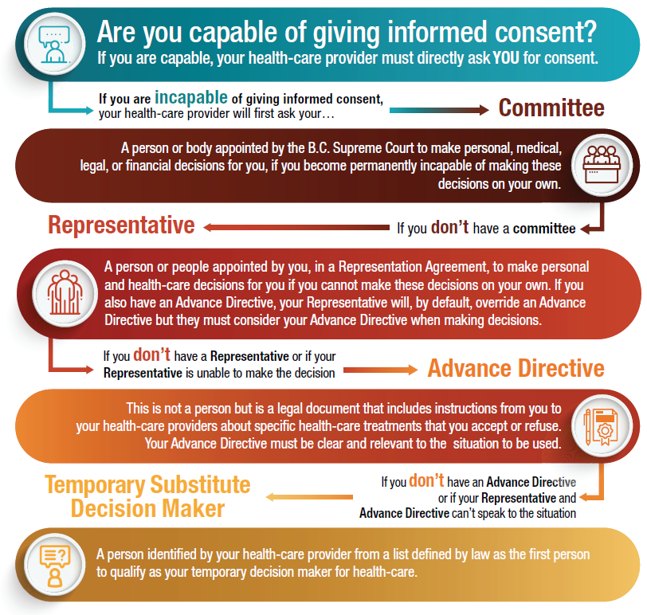
Options for
Substitute Decision Makers in Health Care
adapted from People’s Law School: https://www.peopleslawschool.ca/everyday-legal-problems/planning-your-future/health-personal-care/list-potential-temporary
Notes:
(Note: participants will not be able to read everything on the chart from the PPT slide – let them know that they will receive a copy of it at the end of the session.)
Explain Options for Substitute Decision Makers in Health Care
Provide an initial review of the options for substitute decision makers in health care by sharing this chart:
Emphasize that the above information is ONLY for health-care decisions.
For legal and financial decisions, they can use an Enduring Power of Attorney. Advise them to consult a lawyer or financial advisor.
An Enduring Power of Attorney is not for health-care or personal-care decisions.
Note to facilitators: Committeeship - if needed, refer to the Glossary for an expanded definition and to legal assistance.

Slide 32
Option #1 for Substitute Decision Makers
Temporary Substitute Decision Maker
The law ensures you always have a substitute decision maker.
If you haven’t legally named a representative ahead of time, your health-care provider will follow the Temporary Substitute Decision Maker (TSDM) list.
Notes:
Explain the Temporary Substitute Decision Maker list
If you have not legally named someone (a representative), BC law provides a list that defines who is chosen to make health care decisions for you when you are incapable of making them for yourself.
A Temporary Substitute Decision Maker is selected by a health-care provider if:
you need health care, and
you are not capable to make the decision, and
you do not have a Representation Agreement or an Advance Directive that speaks to the situation.
The authority of a Temporary Substitute Decision Maker only applies to the specific health-care decision at hand.
If another decision is needed and you are still not capable of making the decision, your health-care provider will use the list again to identify a Temporary Substitute Decision Maker.

Slide 33
Temporary Substitute Decision Maker List
Spouse (common law, any gender)
Child
Parent
Brother or sister
Grandparent
Grandchild
Anyone else related by birth or adoption
Close friend
A person immediately related by marriage
Public Guardian & Trustee
To qualify, the person must:
be 19 or older,
be capable,
have no dispute with you, and
have been in contact with you in the past year.
Notes:
To qualify to be a TSDM the person must:
be least 19 years of age or older
be capable
have no dispute with you
have been in contact with you in the past 12 months, and
be willing to comply with their duties as a TSDM
Your health-care provider will work down the following list that is defined in law.
Your spouse, including common-law, same sex (the length of time living together doesn’t matter)
One of your children (equally ranked)
A parent (equally ranked)
A sibling (equally ranked)
A grandparent (equally ranked)
A grandchild (equally ranked)
Anyone else related by birth or adoption
Close friend
Person immediately related by marriage
10. If no one can be reached or qualifies, someone authorized by the Public Guardian and Trustee will be chosen. This person may be an employee of the Public Guardian and Trustee.

Slide 34
Limitations of a Temporary Substitute Decision Maker
Only for health-care decisions, not personal care
Only appointed for one set of decisions; may not be the same person every time
You do not get to decide the order
Person selected may not be who you would trust to make health-care decisions for you
Notes:
Explain the Limitations of a Temporary Substitute Decision Maker
A Temporary Substitute Decision Maker can only make health-care decisions for you. They cannot make personal care decisions.
Personal care decisions are about your daily life, such as:
Living arrangements (including admission to a care facility)
Diet and dress, and other day to day decisions
Participation in educational, vocational or social activities
Who you have contact with
Access to personal information
Restraint issues.
A Temporary Substitute Decision Maker is only appointed for one decision (or set of decisions).
The person selected to be your Temporary Substitute Decision Maker may not be the same person every time. Depending on the eligibility and availability of people on the list the person selected may change for different decisions.
You do not get to decide the order of the Temporary Substitute Decision Maker list
You do not get to decide who your health-care provider selects as your Temporary Substitute Decision Maker if more than one person qualifies within a category of the list (for example if you have more than one child, the health-care provider can choose which to select).
The person selected to be your Temporary Substitute Decision Maker may not be someone you would trust to make health-care decisions for you.

Slide 35
Spouse (common law, any gender)
Child
Parent
Brother or sister
Grandparent
Grandchild
Anyone else related by birth or adoption
Close friend
A person immediately related by marriage
Public Guardian & Trustee
Temporary Substitute
Decision Maker List
Who would be on your list?
How do you feel about that?
Notes:
(Note to facilitators – TSDM list is shown again as a reference for participants for the discussion.)
Discussion Break: Are you aware of this B.C. legislation?
Who would be on your Temporary Substitute Decision Maker list?
How do you feel about that?
Suggest they use the list to write down the names and contact information of the people who would potentially qualify to be their Temporary Substitute Decision Maker. (A form is available in My Voice, pages 28-29)
“Is there anyone on your list that does not qualify, for example because of a dispute?”
Let them know that they can indicate this on their contact information for TSDM.
Inform participants that if the TSDM list does not work for them, they should consider appointing a Representative using the Rep 9 form, which is for capable people.
Many of the limitations of a Temporary Substitute Decision Maker do not apply for a Representative.
A Representative can also make personal-care decisions for you.
You get to choose exactly who your Representative(s) is, and who are your Alternate Representative(s).
Appointing a Representative gives the best chance of the person(s) making decisions for you being the same person(s) over time.

Slide 36
Option #2 for Substitute Decision Makers
Representation Agreement
A legal document naming one or more capable adult(s) to make personal and health-care decisions for you
Can specify which decisions they can make
Can specify how they may act
You do not need a lawyer or notary but you may wish to involve one.
Notes:
Introduce the legal documents
Legal documents are specific to each legal jurisdiction - we will be discussing options for BC only. There are different legal documents to help you plan for the future.
Documents requiring FULL capability:
Representation Agreement Section 9 – Enhanced (RA9)
Advance Directive
Document that can be made with REDUCED capability:
Representation Agreement Section 7 – Standard (RA7)
Explain Representation Agreement as a Planning Option
A Representation Agreement is a legal document in which you name a capable adult, called a Representative, to make personal-care and health-care decisions for you, if you cannot make these decisions on your own.
You can name more than one person to act as your Representative.
You can also specify which decisions they can make, for example, you can appoint someone to make personal-care decisions for you and someone else to make health-care decisions for you in the same agreement.
You can specify how they may act. Unless they have different areas of authority, your representatives must act together (act unanimously) unless your RA says otherwise.
Caution: If you appoint two or more representatives in an RA and one is no longer able to act for any reason, the remaining representative cannot continue to act unless the RA says otherwise. This may or may not be what you want. If you want one representative to be able to continue, your RA must address this.¹
You do not need a lawyer or notary to prepare a Representation Agreement, but you may wish to involve one.
You can also appoint an alternate representative.
This is someone who can step in if your first representative is no longer willing or able to act for you.
If you appoint an alternate representative, you must specify in the agreement when they can act in place of the representative.
¹ Public Guardian and Trustee of British Columbia. It’s Your Choice: Personal Planning Tools. September 2019, www.trustee.bc.ca/documents/STA/It%27s_Your_Choice-Personal_Planning_Tools.pdf

Slide 37
Representation Agreement
Section 9 – Enhanced | Section 7 - Standard
Used by a capable person | Can be used by person with lessened capacity
Representative can make personal care and health care decisions | Representative can make personal care and minor and major health care decisions
Includes decisions about life support & life prolonging treatments | Cannot make decisions to refuse life support
Cannot make financial decisions (can make an Enduring Power of Attorney) | Provides for routine management of financial and legal affairs
Notes:
There are two types of Representation Agreements:
Section 9 (Enhanced) – can be used by a capable person to name a Representative to make personal-care and health-care decisions, including decisions about life support and life prolonging treatments.
Section 7 (Standard) – can be used by a person with lessened capability (e.g. with progression of dementia) to appoint a Representative who can make personal care and minor and major health care decisions, as well as provide routine management of the person’s financial affairs and legal affairs.
The key differences between the two types of Representation Agreements:
To make a Section 9 agreement, a person must have full capacity. A person with diminished capacity can make a Section 7 agreement.
A Section 9 Representative can make more health-related decisions than a Section 7 Representative. A Section 7 Representative cannot make decisions to refuse life support treatments, but a Section 9 Representative can.
A Section 7 Representative can make routine financial decisions. A Section 9 Representative cannot make financial decisions - a capable person can make an Enduring Power of Attorney for this.
Describe examples of when a Representation Agreement (Section 9) might be helpful
When you may need someone to help you with personal care decisions. Appointing a Representative is the only way in the law that someone you choose can make these decisions for you .
if you have an early diagnosis of dementia and are still capable of making decisions for yourself, but know the time will come when you will not be able to do so;
for consistency in care and decision-making (with only one person making decisions on your behalf);
when the person on the TSDM list is not who you wish your SDM to be; or
in cases of family conflict.
Emphasize that:
If you decide to appoint one or more Representatives, it is important to TALK to your Representatives beforehand to make sure they agree to this and that they know your wishes, values and preferences for health and personal care.
It is recommended that people with a diagnosis of dementia involve a lawyer or notary public in making a Representation Agreement, especially if:
There are any concerns about capability, such as with progression of dementia.
They anticipate family dispute or confusion over the health-care decision making.
Their requirements don’t fit in the standard templates (for example, would like to appoint multiple Representatives with each making a specific set of decisions, an alternate and/or a monitor).
Additional Information for Facilitators:
A monitor can also be appointed to oversee the activities of Representative(s) to make sure they follow what is in the agreement.
A monitor is mandatory in a Section 7 agreement that allows the Representative(s) to make routine financial decisions unless:
the Representative is the spouse, the Public Guardian and Trustee, a trust company, a credit union, or
two Representatives are appointed to act unanimously.

Slide 38
Option #3 for Substitute Decision Makers
Advance Directive
A legal document for accepting or refusing specific health-care treatments
You must be capable to make an AD
Your instructions must be honoured, as long they address the treatment offered at the time
Talk to your health-care provider before making an Advance Directive
Notes:
Explain Advance Directive as a Planning Option
An Advance Directive is a legal document that records your instructions for accepting or refusing specific health-care treatments.
You must be capable to make an Advance Directive.
An Advance Directive only covers health-care decisions, not personal-care, financial or legal decisions.
An Advance Directive gives instructions to your health-care provider at a time when you need health care but aren’t capable of providing consent.
It must be:
clear about the specific treatment(s) you would want or refuse;
in writing; and
signed, witnessed and dated.
Describe some examples of when you might want to make an Advance Directive:
you do not have anyone you want making health-care decisions for you,
“I do not have any family to make my health-care decisions. I have lived with kidney disease for 10 years. I want to prepare for a time when dialysis is not working so I made an Advance Directive to provide for refusal of dialysis if I am not able to provide consent and dialysis is prolonging my suffering rather than promoting my health.”
you have certain instructions you want to be legally binding, or you want to spare your decision maker from making certain decisions.
“I have lung disease and have been on a breathing machine four times. I know I’m not well and have decided that I want to be free of pain but don’t want a breathing machine again. I want the doctor to talk about my care with my friends and family but I don’t want the doctor to ask them to make this decision for me. It’s not easy but it’s right for me. I’ve decided to make an Advance Directive.”
Emphasize this: It is very important to TALK with your health-care provider before making an Advance Directive to ensure:
You understand the treatment options,
The directive is clear and specific, and
You understand how what you write would be interpreted.
It’s hard to cover every possible decision in an Advance Directive, so it is still important to have a Representative to be your voice when you are unable to speak for yourself.
Because the Advance Directive is a legal document, your substitute decision maker(s) and health-care providers must honour its instructions, as long as what is written is current, relevant and addresses the specific treatment you need at the time.
Your health-care providers will ask your substitute decision makers to make any treatment decisions that are not clearly specified in your Advance Directive.
If you have both a Representation Agreement and an Advance Directive
Your Representative will still be asked about all decisions, unless you state in your Representation Agreement that they should not be asked about decisions covered by your Advance Directive.
Your Representative should use your Advance Directive to guide them in making decisions on your behalf.

Slide 39
Prepare an Advance Care Plan
What to include in your Advance Care Plan:
What matters most to you: your values, beliefs and wishes for health and personal care
Temporary Substitute Decision Maker list
Legal document(s) you choose to make:
      a Representation Agreement
      an Advance Directive
Remember: Conversations are key!
Notes:
What to include in your Plan?
Written record or video/audio recording of what matters most to you: your values, beliefs and wishes for health care and personal care;
A contact list of your eligible Temporary Substitute Decision Makers, with notes about who on the list is ineligible;
Any legal document(s) you choose to make:
a Representation Agreement
an Advance Directive
Remember: having conversations about what matters most with the people you trust is key!

Slide 40
Examples of
Advance Care Plans:
Notes:
Facilitator Tip: Share 2-3 examples of Advance Care Plans to show how different they can be. The examples used on the slide are Letter from Mom and JKs Advance Care Plan. (see Resources for Facilitators in Appendix C)
Participants will not be able to read these plans from the slide – read parts of each out loud so that participants get a sense of the different approaches. Let particpants know that they will have access to these examples at the end of the session.

Slide 41
Share your Plan
Keep documents together in a safe place
First responders check on or near the fridge
Share your plan with:
  your Substitute Decision Maker
  close family and friends
  your health-care providers
Bring documents with you to the hospital
Notes:
Explain what to do with an Advance Care Plan
Keep all documents together in a safe place where it can easily be found if needed. Be sure to tell your family where this is.
First responders know to check on or near the fridge for health-care planning documents
Share copies with your Substitute Decision Maker, close family and health-care provider(s).
Bring the documents with you if you go to hospital.

Slide 42

Review your Plan
Why: health and treatment choices and life circumstances change
When:
  at least once a year
  when you have a change in health
  if your life circumstances change
  if your relationship with SDM changes
How: Think - Talk – Plan
Share updated documents
Review
Notes:
Emphasize that Advance Care Planning is not a one-time thing
Explain the importance of reviewing your Advance Care Planning
Why?
Our health, our illnesses, and our treatment choices change over time.
As our health changes, so do our decisions about what we consider to
be tolerable and intolerable.
What might seem like an intolerable quality of life when we look down
the road, may look more tolerable when we get there.
It’s necessary to keep thinking about what is important to you based on your current health and life situation, and share your thoughts with the people closest to you.
As your health and life circumstances change, you may want to document your wishes using legal documents, such as Advance Directives or Representation Agreements.
If your relationship with your chosen Substitute Decision Maker changes, you may wish to choose someone else.
When?
It’s recommended to review your Advance Care Plan and all accompanying legal documents at least once a year. You should also review your Advance Care Plan:
When there is a change in your health (for example, new diagnosis of a serious illness, decline in health).
If your life circumstances change (for example, if you move).
If your relationship with your Substitute Decision Maker changes (for example, you get married divorced, or widowed).
How?
Think Revisit the same questions as before, in light of any new circumstances. See whether your thoughts have changed.
THINK again about what matters most to you
THINK again about who could make decisions for you if you cannot
Talk If your wishes have changed:
TALK to the people you trust, including your Representative(s) and any Alternate Representative(s) if you have them.
TALK to your health-care providers.
If nothing has changed:
Remind the people you trust, including your Representative(s) and Alternate Representative(s) if you have them.
Review with the people you trust where your most up-to-date Advance Care Plan is located.
Plan
If you would like to make changes to any of your Advance Care Planning records and documents, do not make changes to the original copy. There are specific requirements for making changes to Representation Agreements and Advance Directives.
If you update any documents, make sure to give copies to anyone who had copies of the old documents. Ask them to destroy copies of the old documents.
These additional notes for facilitators are included in case you are asked a question:
Documents of what matters most to you: record any changes after talking to people you trust, including your Representative(s) and Alternate Representative(s) if you have them.
Legal Documents: Representation Agreement:
You can end your Representation Agreement by writing a notice of revocation. This must be signed and dated. You need to give a copy to your Representative(s), and any Alternate Representatives.
If you make a new Representation Agreement you should refer to the old agreement in the new one stating that it’s revoked. This will provide certainty who has authority to act for you. For example, “I have revoked my prior representation agreement dated______.”
Advance Directive:
It’s best to put in writing that you intend to revoke the Advance Directive. You can write this in a new advance directive, or in a separate document. However, you can revoke your Advance Directive by destroying it with the intention of revoking it.

Slide 43
Advance Care Planning …
Part of life planning, for every adult
The sooner, the better
Helps you get care that’s right for you
Legal documents can give you more control
Notes:
Summarize the key messages about Advance Care Planning (continued on next 2 slides):
Advance Care Planning is a part of life planning. It is for every adult and not just for people who are old or sick.
The sooner you start your Advance Care Planning, the better!
Advance Care Planning is voluntary. But given the many benefits of Advance Care Planning, you should prepare an advance care plan to help you get the care that is aligned with your wishes and beliefs.
Making Advance Care Planning legal documents is not mandatory but can give you more control over who can speak for you and the decisions they can make. E.g. a Representative can make personal-care and health-care decisions for you; a Temporary Substitute Decision Maker can only make health care decisions.

Slide 44
Advance Care Planning …
Think
Talk
Plan
Notes:
Summary of key messages continued…
There are three simple steps to Advance Care Planning: Think, Talk, Plan.
Think about matters to you (your values, beliefs, and wishes).
Think who would you choose to be your substitute decision makers.
Talk with the people you trust about what matters most to you.
Talk with your health-care providers to understand your health conditions and share what they should know about you.
Plan by recording your wishes, preparing any legal documents, and sharing them with the people you trust.

Slide 45

Advance Care Planning …
Conversations are key!
Review at key times in your life.
As long as you are capable, your health-care provider will ask you to make decisions about your own care.
Notes:
Summary of key messages continued
Conversations are key! An important step of Advance Care Planning is talking about your values and beliefs with those who might be involved in your health or personal care. This allows them to make the right decisions for you if you cannot make decisions yourself.
The more conversations you have, the easier they get.
Advance Care Planning is not a one-time event. It is recommended that you review your plan at key times in your life, like when there are changes to your health or close relationships.
As long as you are capable, your health-care provider will always ask you to make decisions about your own care, regardless of whether or not you have an advance care plan in place.

Slide 46
Questions?
Take Home Resources
In the Next Month:
Evaluation Forms
Think
Talk
Plan
Notes:
Ask for final questions
Share the take-home resources
Review the content of the handout(s) you will be sharing with participants.
Encourage participants to complete their Advance Care Planning over the next month.
Here is a script you can use:
Thank you for joining us over this Advance Care Planning session and sharing your stories. We encourage you to take what you have learned and use the resources we provide to get started on your advance care plan over the next month by:
Recording what matters most to you: your wishes, values, preferences for health and personal care. You may wish to talk to your health-care providers to gain a better understanding of your health conditions and treatment options.
Writing down a contact list of the eligible Temporary Substitute Decision Makers in your life and making notes of who is not eligible.
Deciding if you want to appoint your substitute decision maker with a Representation Agreement and who that will be.
Sharing and having conversations about what matters most with your substitute decision makers, your health-care providers, and others you trust.
Distribute evaluation survey
Encourage each person to complete the survey prior to leaving the session – your feedback enables us to improve the session.

Slide 47
THANK YOU!
Notes:
You may choose another way to end the session and substitute a different slide in place of this one.

